Slide 1
Welcome to Free GST Education_ Seminar Organized by Top GST Experts
Host : - Co Host : -
CA Milin Shah - CA Jinal Ruparel
- KETAN GADA

Slide 2
Basics about GST What is GST??
GST is a destination based tax on consumption of goods and services. It is proposed to be levied at all stages right from manufacture up to final consumption with credit of taxes paid at previous stages available as setoff. In a nutshell, only value addition will be taxed and burden of tax is to be borne by the final consumer.
Taxable goods and services are not distinguished from one another and are taxed at a single rate in a supply chain till the goods or services reach the consumer.
Exports would be considered as zero-rated supply and imports would be levied the same taxes as domestic goods and services adhering to the destination principle in addition to the Customs Duty which will not be subsumed in the GST.

Slide 3
Why GST is Necessary ?.
Issue in existing tax regime
GST tax System_ benefit
Cascading Effect _ Means tax on tax
Multiple tax leads increase in compliance cost
Due to heavy cost exporters are not able to compete with world
Was Difficult to curb black money”& Corruption
Inefficient dispute resolution system in the current indirect tax regime ( SEZ- Export Zone better in China)
All Major Indirect Taxes are subsumed into one Tax. Saving in compliance & procedural cost for businessman as well for government
Free flow of Input Tax credit means no cascading effect _ Tax on Tax
Transparency in Tax flow ( Everything will be online through GSTN)eventually help to curb black money & corruption
Effective dispute resolution system will attract foreign investor
Indian market will be more competitive with the world
Overall Growth in economy

Slide 4
GST Bill Finalized & Input credit system
CGST
CGST
IGST
SGST
SGST
IGST
UTGST
IGST
CGST
SGST
IGST

Slide 5
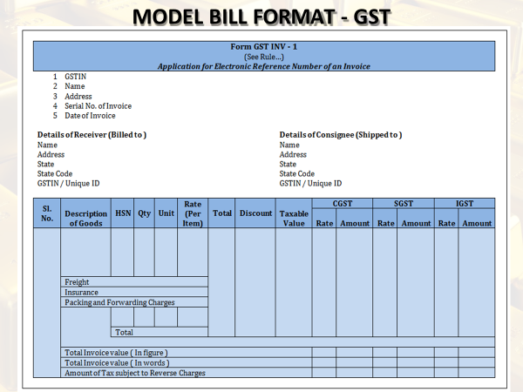

Slide 6
GST RATES
Sr. No. | Rate | Description
1 | 0% | Essential items including food
2 | 5% | Common usage items
3 | 12% and 18% | Standard Rates
4 | 28% | Items which are Currently taxable with (30-31%)
5 | 28% with Cess | Luxury and de-merit Goods

Slide 7
Important definitions 1 “Supply”
Definition of ‘supply’ Under section 2(92) read with section 3 ‘supply’ includes all forms of supply of goods and/or services such as sale, transfer, barter, exchange, license, rental, lease or disposal made or agreed to be made for a consideration by a person in the course or furtherance of business.
Schedule I specified the supply.
Supply Includes : -
(b) Importation of service, whether or not for a consideration and whether or not in the course or furtherance of business, and
(c) a supply specified in Schedule I, made or agreed to be made without a consideration

Slide 8
Schedule II, in respect of matters mentioned therein, shall apply for determining what is, or is to be treated as a supply of goods or a supply of services.
(3) Notwithstanding anything contained in sub-section (1),
(a) activities or transactions specified in schedule III; or
(b) activities or transactions undertaken by the Central Government, a State Government or any local authority in which they are engaged as public authorities as specified in Schedule IV,
shall be treated neither as a supply of goods nor a supply of services.
(4) The Central or a State Government may, upon recommendation of the Council, specify, by notification, the transactions that are to be treated as—
(a) a supply of goods and not as a supply of services; or
(b) a supply of services and not as a supply of goods; or
(c) neither a supply of goods nor a supply of services.
(5) The tax liability on a composite or a mixed supply shall be determined in the following manner —
(a) a composite supply comprising two or more supplies, one of which is a principal supply, shall be treated as a supply of such principal supply;
(b) a mixed supply comprising two or more supplies shall be treated as supply of that particular supply which attracts the highest rate of tax.

Slide 9
2. “Goods’’
- Means every kind of movable property other than money and securities but includes actionable claim, growing crops, grass and things attached to or forming part of the land which are agreed to be severed before supply or under a contract of supply
3. “Services’’
- means anything other than goods;
Services does not include transaction in money other than an activity relating to the use of money or its conversion by cash or by any other mode, from one form, currency or denomination, to another form, currency or denomination for which a separate consideration is charged.
4. “Aggregate turnover”
= Value of all taxable supplies+ exempt supplies+ export of goods and/or services+ all inter-state supplies of a person having same PAN –taxes (CGST+IGST+SGST as the case may be)-* not covered inward supplies on which tax payable under reverse charge

Slide 10
5. “Business”
includes – (a) any trade, commerce, manufacture, profession, vocation, adventure, wager or any other similar activity, whether or not it is for a pecuniary benefit;
any activity or transaction in connection with or incidental or ancillary to (a) above;
any activity or transaction in the nature of (a) above, whether or not there is volume, frequency, continuity or regularity of such transaction;
supply or acquisition of goods including capital assets and services in connection with commencement or closure of business;
provision by a club, association, society, or any such body (for a subscription or any other consideration) of the facilities or benefits to its members, as the case may be;
admission, for a consideration, of persons to any premises; and
(services supplied by a person as the holder of an office which has been accepted by him in the course or furtherance of his trade, profession or vocation;
services provided by a race club by way of totalizator or a license to book maker in such club;
Explanation.- Any activity or transaction undertaken by the Central Government, a State Government or any local authority in which they are engaged as public authorities shall be deemed to be business.

Slide 11
6. “Consideration”
Consideration in relation to the supply of goods or services includes
any payment made or to be made, whether in money or otherwise, in respect of, in response to, or for the inducement of, the supply of goods or services, whether by the recipient or by any other person but shall not include any subsidy given by the Central Government or a State Government;
The monetary value of any act or forbearance, whether or not voluntary, in respect of, in response to, or for the inducement of, the supply of goods or services, whether by the recipient or by any other person but shall not include any subsidy given by the Central Government or a State Government:
PROVIDED that a deposit, whether refundable or not, given in respect of the supply of goods or services shall not be considered as payment made for the supply unless the supplier applies the deposit as consideration for the supply;

Slide 12
Anti Profiteering Clause
What is Anti Profiteering Clause
Clause 171 has been inserted in the GST bill which provides that it is mandatory to pass on the benefit due to reduction in rate of tax or from input tax credit to the consumer by way of commensurate reduction in prices.
Benefited to Consumer
Majorly Impact on Real Estate & Infrastructure sector
Not easy to track whether benefit is passed on to customer or not

Slide 13
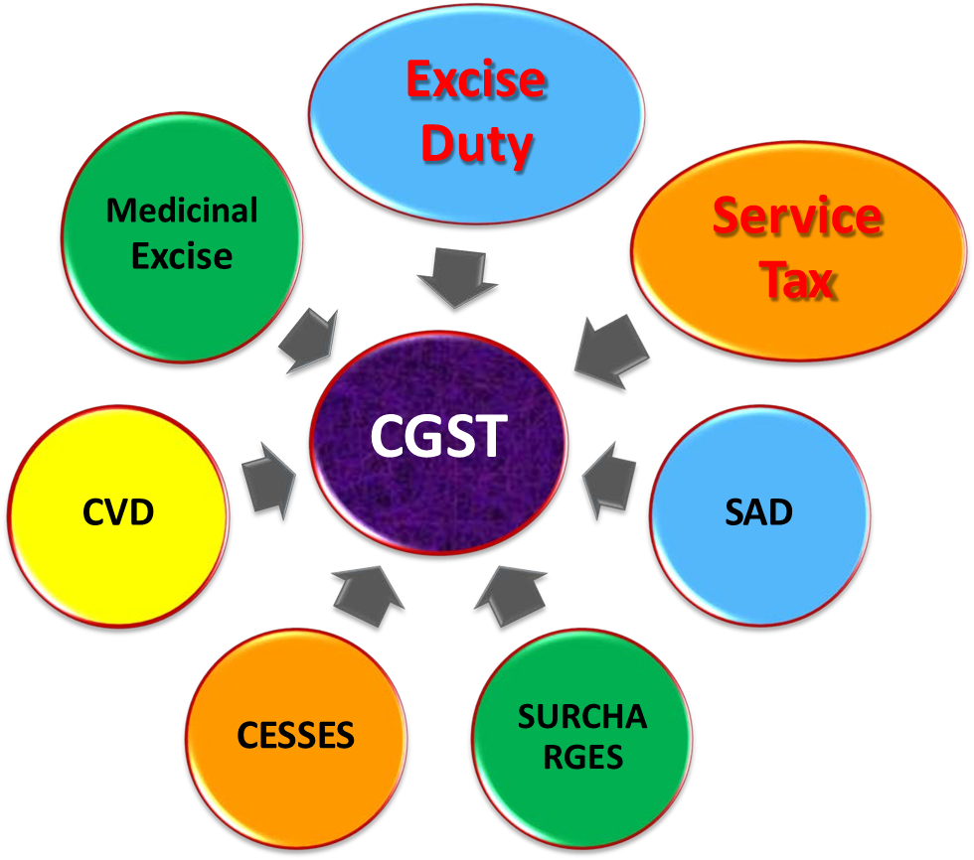
Taxes subsumed under CGST

Slide 14
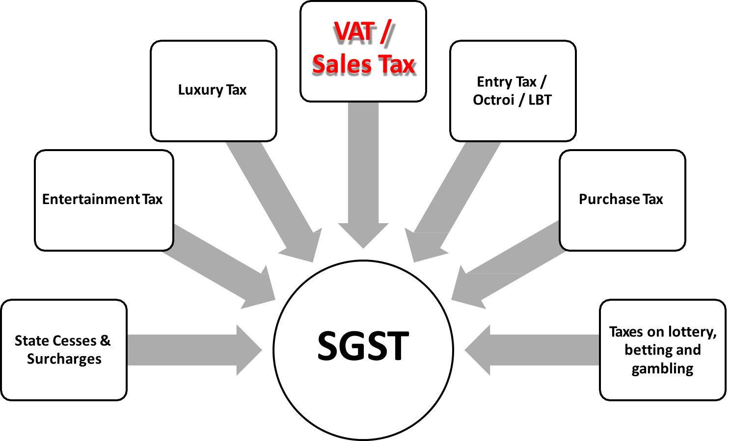
Taxes subsumed under SGST

Slide 15
Taxes not subsumed under GST
Basic Custom Duties
Excise on liquor
Property Tax
Stamp Duty
Tax on sale/consumption of electricity

Slide 16
Products not covered under GST
Petroleum Crude
Motor Spirit(Petrol)
High Speed diesel
Natural Gas
Aviation turbine fuel
Liquor
Note : -What will be status of Tobacco and Tobacco products under the GST regime?
Ans. Tobacco and tobacco products would be subject to GST. In addition, the Centre would have the power to levy Central Excise duty on these products.

Slide 17
Applicability of GST
Every supplier shall be liable to be registered under GST in the state from where he makes taxable supply of goods and/or services if his aggregate turnover in a financial year exceeds threshold limit as announced by GST Council on 24.09.2016 of :
20 lakh;
10 lakh in North Eastern States including Sikkim.
If you are purchasing or selling goods outside the state irrespective of the limit
If you are receiving or providing services outside the state irrespective of the limit
If you are required to pay tax under reverse charge.
If you are non-resident taxable person irrespective of the limit.
Input Service Distributor

Slide 18
An aggregator who supplier services under his brand name or his trade name irrespective of the limit mentioned in point 1.
Every electronic Commerce operator like Flipkart, Amazon, etc., irrespective of the limit
A person who supplies goods and services through electronic commerce. In other words, if you want to sell on Flipkart, Amazon, then you will need to register yourself first irrespective of the limit mentioned in point 1.
Any person who is required to deduct TDS under GST (not under Income Tax Act, 1961).
Every person who is liable to be registered under this Act shall apply for registration in every such State in which he is so liable within thirty days from the date on which he becomes liable to registration, in such manner and subject to such conditions as may be prescribed.
A person having multiple business verticals in a State may obtain a separate registration for each business vertical, subject to such conditions as may be prescribed.
A person, though not liable to be registered under Schedule V, may get himself registered voluntarily, and all provisions of this Act, as are applicable to a registered taxable person, shall apply to such person.

Slide 19
Impact of GST on Various Sectors

Slide 20
Impact of GST on Manufacturing Sector
No Excise Duty at the time of Manufacture & GST will be applicable on “SUPPLY”. Will be great relief to all Manufacturer.
Reduction in cascading effect ( Like earlier VAT was charged on Value + Excise amount)
Hassle Free Supply of Goods _ because on no Entry Tax/Octroi
Increased Working Capital Requirements (Because Branch Transfer will be treated as supply)
Free Supplies & After Sale discount will be burden on supplier
Valuation of Self Supplies required clarity
Pre packaged products for retail consumption valued on MRP leading higher cost price which is unlikely in GST
Reduction of classification disputes

Slide 21
Impact of GST on Traders & Resellers
Reduction in Cost because of cross input tax credit available
No Cascading effect will reduced cost & ultimate benefit to customer
No need to open multiple branches in different states as claim of interstate purchase & interstate sale is available now.
GST compliance will be burden for small traders & retailers, Comsidering higher no. of returns and montly credit matching concept
Filling of monthly returns with purchase & Sales monthly cross examination helps to curb circulations of dummy purchase and sales invoices in the market

Slide 22
Impact of GST on Service Sector
Services will be costlier but free flow of ITC may curtail the cost to some extent
Example : -
“Services provided by beauty parlour in which goods are used to provide the service to the client, however its providing output service and not trading in goods can not claim input credit on VAT paid on that products”
Number of filing return will increase as against only two half yearly returns in current indirect tax regime
Centralized Registration will become Decentralized Registration in GST ( Will be tough for few industries like Telecommunication Industry)
Services are often delivered through third party vendors and hence, determining point and time of supply is ambiguous.
Reverse and partial charge mechanism likely to continue under GST

Slide 23
GST Impact on import of Goods & Services
With Constitutional Amendments, both CGST and SGST will be levied on import of goods and services into the country.
The incidence of tax will follow the destination principle(Place of supply rules).
Tax revenue in case of SGST will accrue to the State where the imported goods and services are consumed.
Full and complete set-off will be available on the GST paid on import on goods and services.
Thus, import of goods will attract BCD and IGST. It may be noted that import of services, as against service tax at present, in GST regime, will attract IGST.
Basic Custom Duty will continue to there under GST system. However, the additional custom duty in lieu of CVD /Excise and the Special Additional Duty (SAD) in lieu of sales tax/VAT will be subsumed in the import GST.
The import of services will be subject to Central GST and State GST on a reverse charge mechanism. In other words, the GST will be payable by the Importer on a self declaration basis.

Slide 24
GST impact of export of Goods & Services
Export of Goods & Services= Zero rated (Tax-Free/Exempted)
Lower Logistic cost by subsuming Octroi/Entry Tax
Free flow of goods makes Exports faster
Refund of GST paid on Input is also available.
Overall Indian Products will be more competitive
Duty Drawback : -
Earlier there was no provision for duty drawback in GST, but after public & experts opinions, provision of duty drawback has been made in GST which will be a big relief to the exporters.

Slide 25
Particulars | Without GST | With GST
Manufacturer to Wholesaler
Cost of Production | 5000 | 5000
Add: Profit Margin | 2000 | 2000
Manufacturer Price | 7000 | 7000
Add: Excise Duty (12.5%) | 875 | -
Total Value | 7875 | 7000
Add: VAT 13.5% | 1063 | -
Add: CGST 9% | - | 630
Add: SGST 9% | - | 630
Total Invoice Value | 8938 | 8260

Slide 26
Wholesaler to Retailer | Without GST | With GST
COG to Wholesaler | 8938 | 8260
Add: profit Margin(10%) | 894 | 826
Total value | 9832 | 9086
Add: VAT 13.5% | 1327 | -
Add: CGST 9% | - | 818
Add: SGST 9% | - | 818
Invoice Value(COG to Retailer) | 11159 | 10722
Retailer to Consumer
Add: Profit Margin(10%) | 1116 | 1072
Total Value | 12275 | 11794
Add: VAT 13.5% | 1657 | -
Add: CGST/SGST(9%) | - | 2123
Total Price to final Consumer | 13932 | 13917
Cost saving to Consumer | - | 15

Slide 27
How to (Re) Structure your business to get maximum benefit from GST
Accounting will be the “KEY” for compliance
Restructure your branches _ Now Inter state Sale & Purchase set off is available
Restructure your warehousing Logistic & Supply chain management (Entry Tax & Octroi removed)
File your returns on time _ Profit will not be yours but yes loss is yours ( For Ex. You cant forget to carry forward available credit)
Track Credit mismatch data closely_ Reconciled it every month_ you will not get the credit if your seller don’t pay it

Slide 28
How to (Re) Structure your business to get maximum benefit from GST
Check whether Your existing staff are enough capable to manage your books after GST??if No Restructure the compliances system and train your existing staff to tackle with new challenges
Re – costing of your product to fix your margin & selling price
Don’t pay more by trying to save few_ Hire proper consultant
Check your business needs full time accountant or not?
Prepare Invoice/Delivery challans/ Stock maintenance all should be electronic to save cost & time.

Slide 29
We, team of Top GST Experts thanking you for attending seminar
You Can contact us on below mentioned details : -
Name : - | CA Milin Shah | CA Jinal Ruparel | Ketan Gada
Ph No. | 9768 961 561 | 9699 544 209 | 9820 672 539
Email Id | topgstexperts@gmail.com | cajinal@gmail.com | ketan_labela@yahoo.com
Web address | www.topgstexperts@gmail.com

